Slide 1
Childhood and growing up
Prepared by
P.RAJENDRAN M.Sc.,M.Phil.,M.Ed., M.Phil., SET.,
ASSISTANT PROFESSOR,
DHANALAKSHMI SRINIVASAN COLLEGE OF EDUCATION
PERAMBALUR 621 212

Slide 2
GROWTH AND DEVELOPMENT

Slide 3
PHYSICAL GROWTH AND DEVELOPMENT
Growth - process of changes
-Height
-Weight
-Speed
-Shape
-Perception
-Emotional control
Development – Life long process

Slide 4
PHYSICAL GROWTH AND DEVELOPMENT
PHYSICAL DEVELOPMENT
COGNITIVE DEVELOPMENT
MORAL DEVELOPMENT
SOCIAL AND EMOTIONAL DEVELOPMENT

Slide 5
Physical Development
-basic for all development
i.e. infancy – 50%
child – 70%
-study of systematic psychological changes i.e. personality, self-concept.
Mental Development
Thinking
Perception
Problem solving
Construction of concepts.

Slide 6
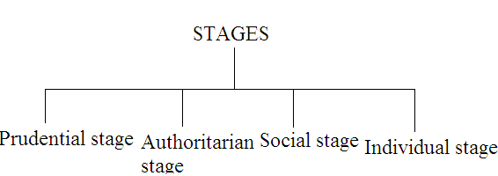
MORAL DEVELOPMENT
-Lives according to socio-moral values moral control
-Based on religious thought, self esteem
Moral development = religious thought +
character
Moral development→ not at birth → due to practise → development

Slide 7
SOCIAL & EMOTIONAL DEVELOPMENT
Key factors in social development:
According to Erikson,Maslow,Elias→
Social development theorist
Children have common needs→ fulfill→
health adult → accept society rules
& values

Slide 8
PIAGET’S THEORY
Believe to think in new & more complex
Cognitive development theory→ Jean Piaget→ Swiss psychologist(1896-1980)
C ENTRAL THEME:
Developmental psychology→→ability to represent,
Growth of intelligence →→→→ perform logical operations
Schemata → Schemes → how to perceives the world.

Slide 9
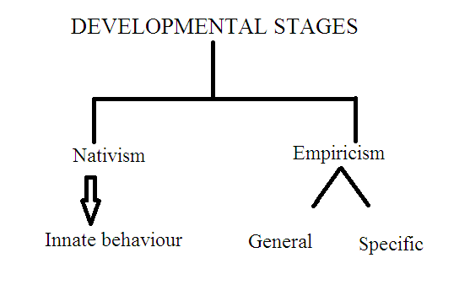
DEVELOPMENTAL STAGES
Empiricism → gradual acquisition of knowledge through experience → Self motivation action

Slide 10
SENSORI MOTOR STAGE
Sub stages:
Reflex Schema Stage→ 0-6 weeks
-development of reflexes
-uncoordinated reflexes
Primary Circular Reaction Phase→ 6 weeks-4 months
-Coordinated into simple schemas
Secondary Circular Reactions phase→4-9 months
-Vision & Prehension -React with objects

Slide 11
Coordination of Secondary Circular Reactions Phase→ 9 -12 months
-Object permanence developed
Tertiary Circular Reactions Phase→12-18 months
-Discovery of new means to meet goals
Beginnings of Symbolic representation→2-7 years
- Insight or creativity ,Mental image ,Symbolic world of language.

Slide 12
PRE-OPERATIONAL STAGE
learning of language→ Create good thinking
Childs activity:
Mental Activity
Objects by images & words
Words used for symbolic thinking
Egocentric
Language skills

Slide 13
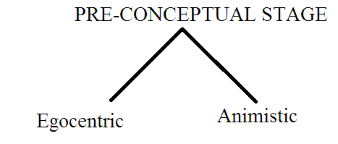
PRE-CONCEPTUAL STAGE(2-4 YEARS)

Slide 14
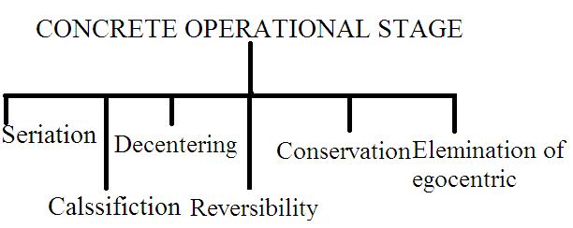
CONCRETE OPERATIONAL STAGE

Slide 15
FORMAL OPERATIONAL STAGE
Final of the periods of cognitive development
Commences at around 11 years of age & continues childhood
Characterized by acquisition of
ability to think,
reason logically
reason logically
Drawing conclusion

Slide 16
Understands
logical proofs
Values
At adulthood-they understands
Philosophy
Cognition
Moral development(Kohlberg)
Psycho sexual development(Freud)
Social devlopment(Erikson)

Slide 17
Challenges of Piagetian theory
Unpredicted gaps
Cognitive domain is bonded on specificity for each other doamin
now a days child understands basic principles

Slide 18
THANK YOU

